Slide 1

Real – Time Marathi Sign Language Recognizer Using ML
TERNA ENGINEERING COLLEGE
DEPARTMENT OF COMPUTER ENGINEERING
BE-A-Comps/Sem-VIII/ DIV-A
Group members:
ROHINI RAI -A52
ARYA PATIL -A59
AVANTIKA GHARAT -A24
MAHII VARIAR -A47
Under the guidance of- MRS. PRAMILA MATE
Academic Year
2023-24

Slide 2
Abstract
Our project focuses on creating a special system that can understand as well as interpret Marathi Sign Language movements in real-time. It then changes these movements into written words, which are spoken out loud using a natural-sounding voice. This technology helps people who know sign language communicate with those who don't, making communication easier and more inclusive for everyone.

Slide 3
Introduction
The ability to communicate is crucial to human existence. It is difficult to detect the expressions without communication is the main task. This project communicates conservation by recognizing various signals and gestures using webcam and convert them into meaningful message. Sign Language Recognition is to detect signs automatically from hand expressions and detect them accordingly. This sign language Recognition involves converting the signs such as hand gestures and interpreting them to assist close the communication gap with the hearing impaired persons. This system will assess the signals, actions, and motions and categorize them into messages using a machine learning technique. As a result, it is necessary to examine the specifics of sign descriptions in order to accurately comprehend them and make judgments about the pictures key details.

Slide 4
Literature Survey
Paper Name | Date | Author’s Name | Merits | Shortcomings
ML Based Sign Language Recognition System Sign Language Recognition: A Deep survey | May 30, 2021 July 20, 2021 | Amrutha K, Prabhu P Razieh Rastgoo, Kourosh Kiani, Sergio Escalera | This paper explores different techniques used in each module of an ML-based SLR system. All the stages like pre-processing, segmentation, feature extraction, classification and recognition are included and well explored in this paper. For classification to be more accurate Lazy learner classifier, Support Vector Machines, Decision Tree, Naïve Bayes, ANN algorithms were compared separately and the best algorithm i.e., KNN was finalised in the model. The paper explored deep learning. The ‘features fusion’ aspect was considered in the project i.e., not only hand poses were considered. Hand, face and body features/poses were identified by this model. Many other research papers were studied by the authors and a thorough comparison was done. | Despite of using so many classification algorithms for the accurate result, model yielded just 65% accuracy which is quite low. The reason was mainly signer's sudden movements of the hand, occlusion of the hands, and the signer's speed are a few of the factors that affect the prediction apart from the illumination condition. The project was not implemented hence the success of using deep learning in SLR is unknown. Deep learning is very vast and not used much, thus more reliable systems have to be developed. The other papers referred in this had many shortcomings & this only includes the sensor-based models not the traditional-based models.

Slide 5
Literature Survey
Paper Name | Date | Author’s Name | Merits | Shortcomings
Marathi Sign Language Recognition | May, 2020 | Swaraj Dahibavkar, Jayesh Dhopte, Mahesh Patole, Sulochana Madachane | This paper uses the image recognition method based on deep learning to translate the Marathi-sign language to alphabets. This system is time efficient as it was capable of handling left and right hand gestures simultaneously. The accuracy of 95-100% was obtained | While working with the system many precautions are to be taken like the background has to be dark/black, non-skin coloured clothes if put on then the recognition of gestures fails. There was no dynamic sign recognition of signs.

Slide 6
Paper Name | Date | Author’s Name | Merits | Shortcomings
Real-time Indian Sign Language Recognition | July 10, 2018 | Kartik Shenoy, Tejas Dastane, Varun Rao, Devendra Vyavaharkar | The image is subjected to a Grid-based Feature Extraction technique which represents the hand's pose in the form of a Feature Vector. Hand poses are then classified using the kNearest Neighbours algorithm. On the other hand, for gesture classification, the motion and intermediate hand poses observation sequences are fed to Hidden Markov Model chains corresponding to the 12 pre-selected gestures defined in ISL. | The existing solutions either provide relatively low accuracy or do not work in real-time. This system provides good results on both the parameters. It can identify 33 hand poses and some gestures from the ISL.
Sign Language Recognition | May 2016 | Anup Kumar, Karun Thankachan, Mevin M. Dominic | The system developed works well in diverse backgrounds and has relatively high accuracy in gesture and speech recognition. For speech recognition Sphinx module was used that turned to be a success. It follows an image-based approach it can be launched as an application in any minimal system and hence has near zero-cost. | Improvement is needed in the performance of the system in unfavourable conditions like a lot of clutter or poor lightning. Larger database should be used to for identifying variety of signs. This system only used American Sign Language hence other sign languages were not accurately detected. Also, expansion in features recognition is needed so that more gesture like those involving two hands can be interpreted correctly.

Slide 7
Paper Name | Date | Author’s Name | Merits | Shortcomings
Advanced Marathi Sign Language Recognition using Computer Vision | May 13, 2015 | Amitkumar Shinde & Ramesh Kagalkar | This paper presents an Automatic translation system for gesture of manual alphabets in Marathi sign language. It deals with images of bare hands, which allows the user to interact with the system in a natural way. Sign language through offline mode was also made available to the users. For the offline detection and recognition of sign language system gives 100% results. | ­­­­A large set of samples has been used to recognize only 43 isolated words from the Standard Marathi sign language. In this system, intend to recognize only few basic elements of sign language and to translate them to text and vice versa in Marathi language. The experiments were performed only with the static hand gestures.

Slide 8
Problem Statement
Develop a real-time sign language recognizer system capable of accurately interpreting a diverse set of sign language gestures and converting them into corresponding text or speech, enabling effective communication between deaf or hearing-impaired individuals and the wider community.

Slide 9
Objectives
The motive is to identify symbolic gestures used in communication and convert it into text.
To develop a model that can handle a large amount of sign language expression data using Python.
To provide simultaneous translation and detection for facilitating smooth interaction and communication along with corresponding labels.
To put effort into accurately recognizing as well as interpreting, and translating the visuals into meaningful expressions.

Slide 10
Scope
MSLR has a large scope in :
Education: In the education field, sign language recognition technology aids students who are deaf or hard of hearing by providing real-time sign language interpretation of lectures and educational content, ensuring their equal access to quality education.
Employment: Sign language recognition enhances workplace accessibility by allowing deaf employees to effectively communicate with colleagues, superiors, and customers, fostering inclusivity and equal job opportunities.
Communication: It enables real-time sign language interpretation for video calls and public events, breaking down language barriers and ensuring that deaf individuals can fully participate in various communication contexts.
Entertainment: Sign language recognition can be utilized in the entertainment industry for automatic sign language interpretation during live broadcasts or events, making entertainment content more accessible to the deaf and hard of hearing audience.

Slide 11
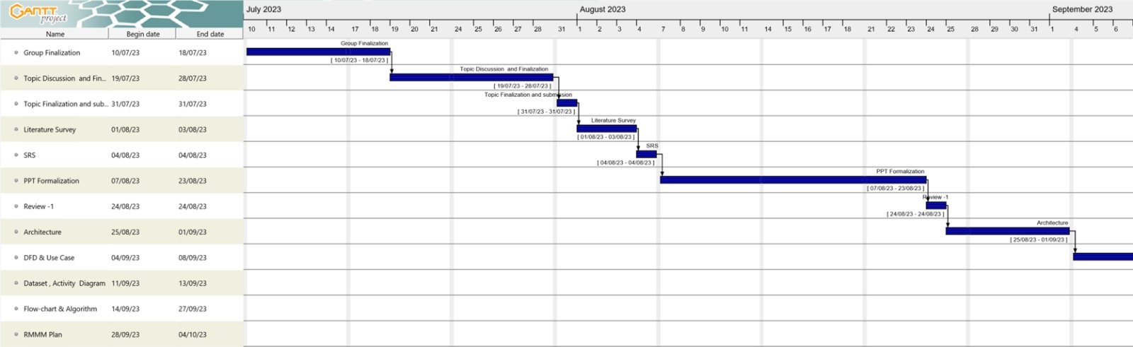
Timeline
7TH SEM

Slide 12
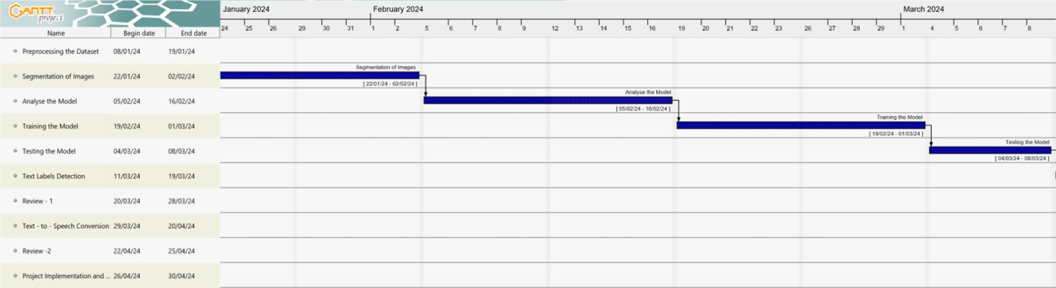
Timeline
8TH SEM

Slide 13
SRS
Functional Requirements :
An image sensor captures the gestures made by the sign language user.
OpenCV tracks the captured gestures by identifying feature points.
The captured data is preprocessed.
The preprocessed data is fed to the model for training and testing.
Based on the data provided, the text will be predicted.
The text selected will be the one with the highest possibility of up to three words.
Predicted text will be displayed on the User Interface/screen.
Once text is predicted it will be converted to speech/voice format.
Users will have the option to turn on speech format for the predicted texts.

Slide 14
Non functional requirements:
The system should be able to accurately recognize the signs and gestures in real time.
The system should be secure and protect the user's private data.
The system can be executed on computer systems having any versions of Windows operating system, macOS that is the system should be portable.
The system should be maintained and controlled only by authorized admins.
The system should be able handle variations in lightning, difference in skin tones, background noises and other environmental factors without affecting the recognition accuracy.
SRS A8.docx

Slide 15
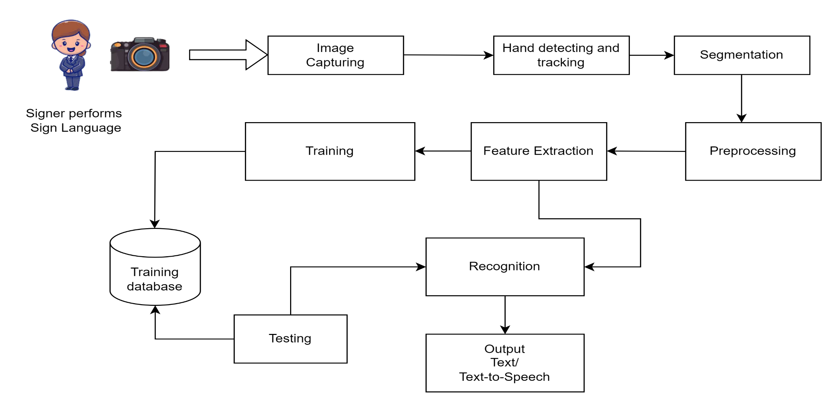
Methodology
Sign Recognition
Sign to Text/Speech Conversion

Slide 16
Methodology Flow
Collect Marathi Sign Language gesture data.
Preprocess and label the data.
Split it into training and testing sets.
Select relevant features.
Train the CNN model.
Validate and fine-tune the model.
Integrate the model into your application.
Test, gather feedback, and improve as needed.
Deploy the Marathi Sign Language Recognizer for practical use.

Slide 17
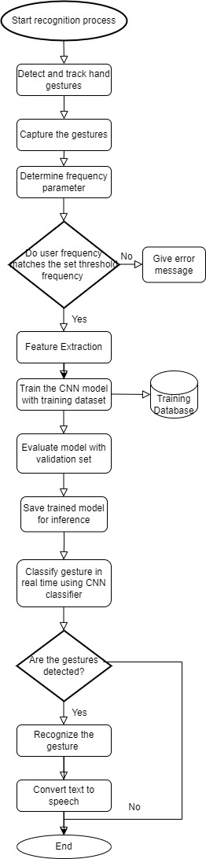
Flowchart

Slide 18
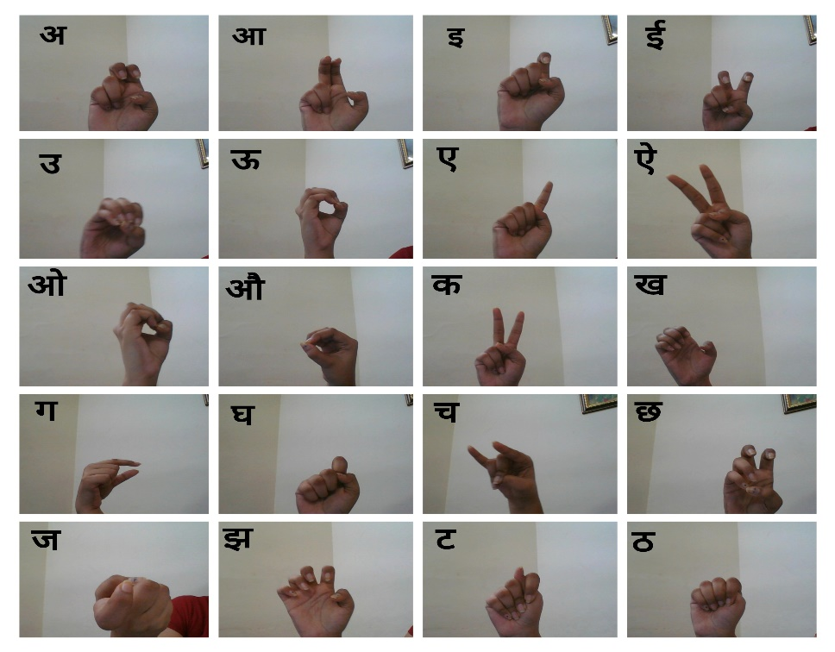



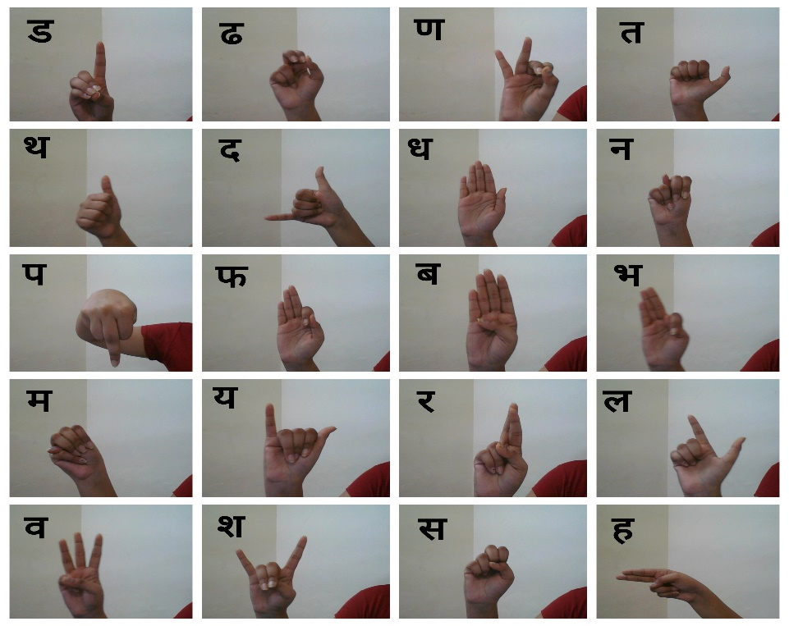
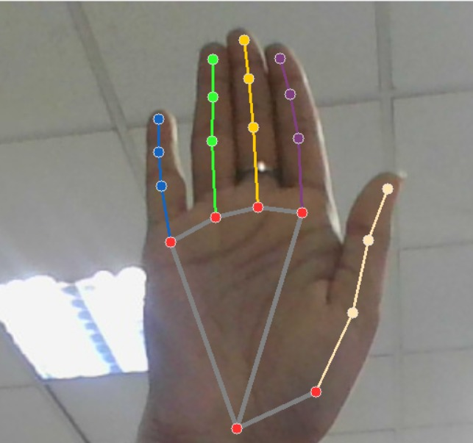
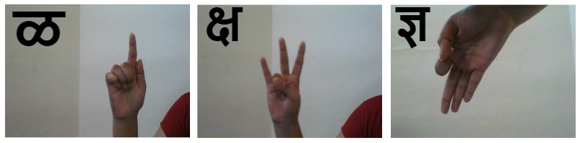
Dataset
अ
आ
क
The 21 landmark points is considered, would be strategically placed on the hand to represent key features of the signs. These landmark points could include positions on the fingers, palm, and other relevant regions of the hand.

Slide 19
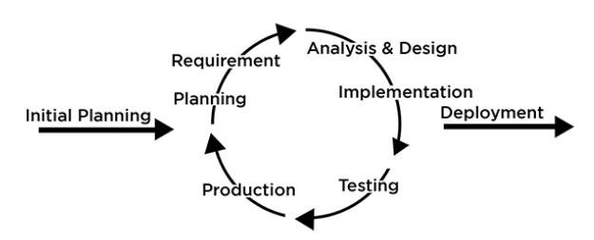
SDLC Model
Iterative and Incremental Model:
Description: This model involves breaking the project into small parts and developing them in iterations, each adding new features or refining existing ones. It allows for flexibility and adjustments as the project progresses.
The Iterative and Incremental Model is an agile software development approach that breaks down a project into small, manageable parts called iterations. Each iteration goes through the entire development cycle, from planning to deployment, with the goal of refining and adding features.
For the Marathi Sign Language Recognition project, the Iterative and Incremental Model is ideal as it enables regular user feedback, progressive refinement of the recognition model, and parallel development of different project aspects. It ensures adaptability to evolving user needs and facilitates a faster time-to-market for essential features.

Slide 20
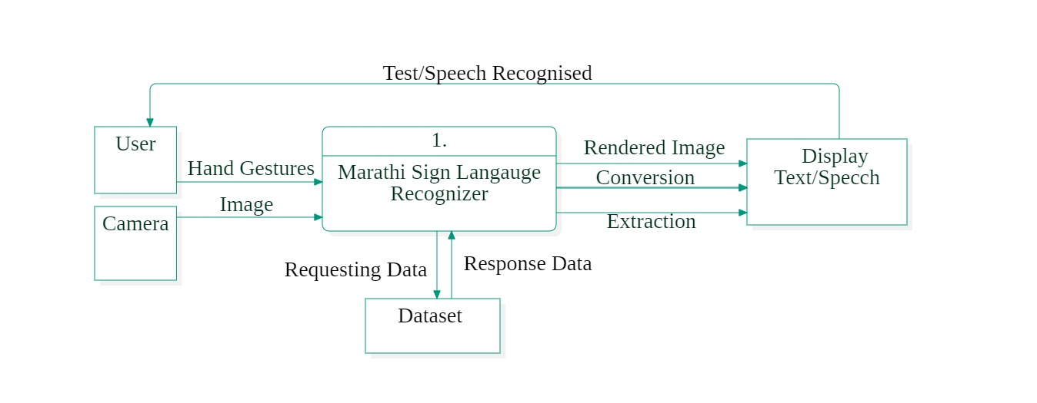
Data Flow Diagram-0

Slide 21
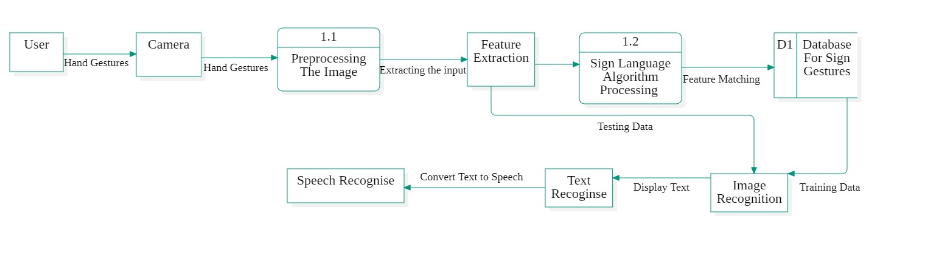
Data Flow Diagram-1

Slide 22
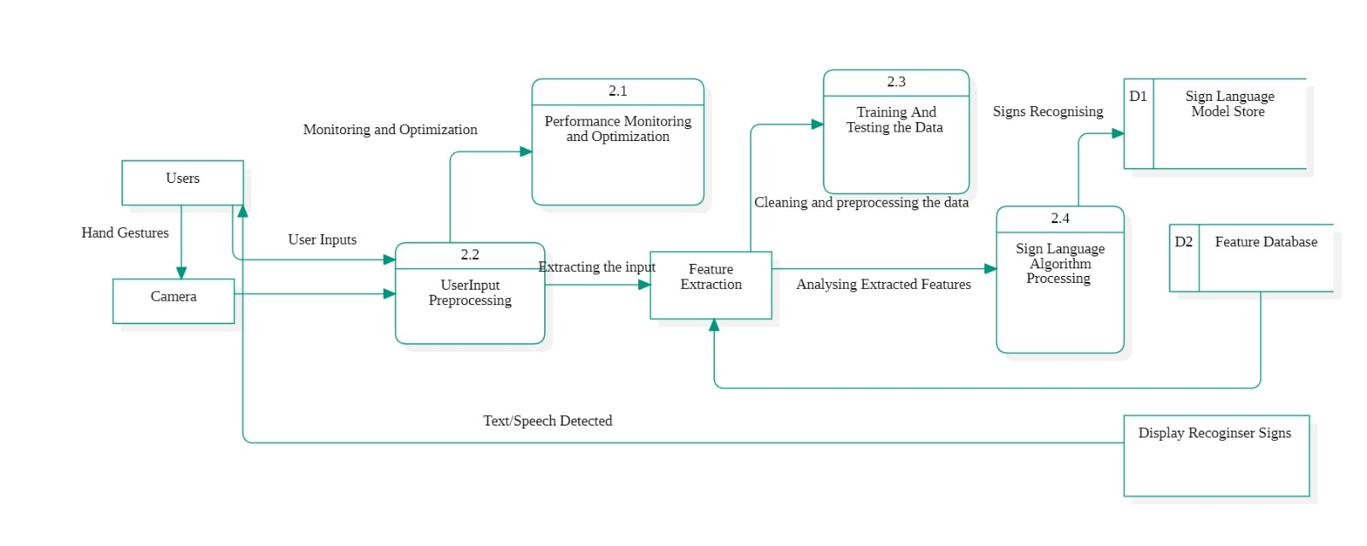
Data Flow Diagram-2

Slide 23
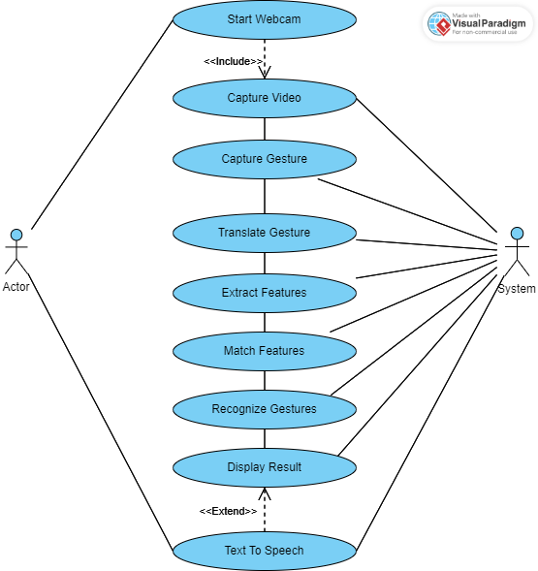







Use Case Diagram

Slide 24
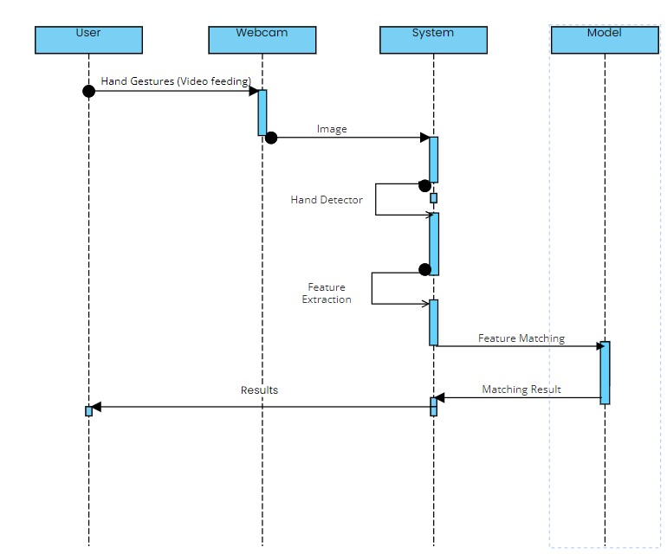
Sequence Diagram

Slide 25
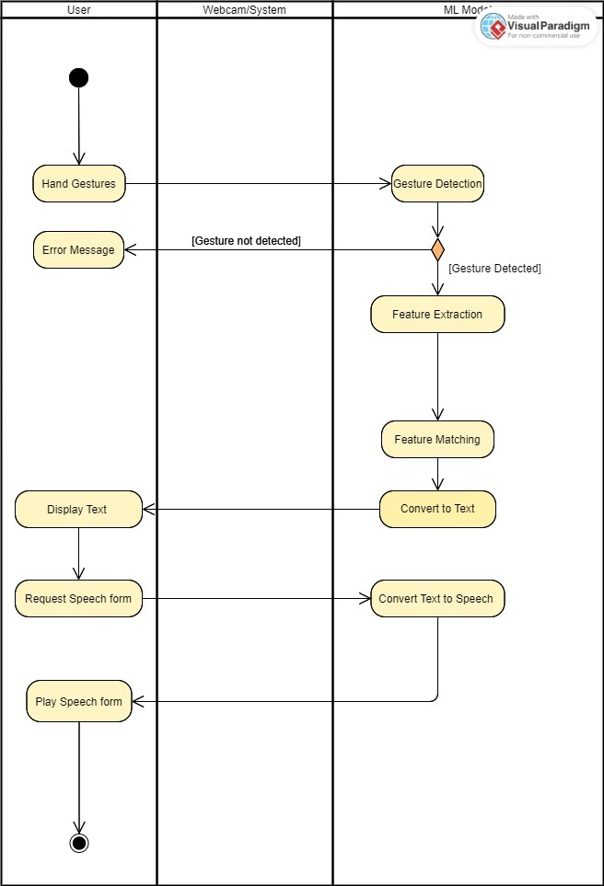
Activity Diagram
ML Model

Slide 26
RMMM Plan
Risk ID | Risk Description | Probability | Impact | Mitigation Strategy | Contingency Plan
R1 | Unforeseen technical challenges in model development | 80% | 3 | Conduct comprehensive feasibility study; collaborate with domain experts; maintain a flexible development schedule | Identify alternative algorithms or pre-trained models; establish a backup team to address and solve the issue
R2 | Inadequate or inconsistent sign language data | 30% | 2 | Implement rigorous data validation processes; ensure diverse and representative dataset. | Explore data augmentation techniques; actively monitor and update the dataset throughout the project.
R3 | Unexpected budget constraints or resource shortages | 20% | 2 | Regularly review the project budget; explore alternative funding sources; maintain clear communication with stakeholders. | Establish a contingency fund for unforeseen budget constraints; seek additional funding if necessary.

Slide 27
R4 | Limited availability of expertise in Marathi SLR | 30% | 3 | Identify and if possible, collaborate with Marathi Sign Language experts and take constant guidance from project mentors | Seek external consultancy from faculty, mentors or other experts to fill expertise gaps.
R5 | Ethical concerns and bias in recognition outcomes | 60% | 1 | Conduct an ethical review of the project; implement fairness-aware machine learning techniques; monitor and address bias in the system. | Regularly audit and update the training data to address bias; establish a diverse and inclusive dataset to minimize biases.
R6 | Delays in project timelines due to unforeseen events | 15% | 2 | Regularly update project timelines; maintain flexibility in development schedules. | Implement a phased development approach; prioritize key features to ensure essential functionalities are delivered on time.

Slide 28
Contingency | Action
System is unavailable | Use a backup system or manual process.
System is not accurate | Retrain the model with more data or use a different model architecture.
System is too slow | Optimize the code or use a more powerful hardware platform.
System is not reliable | Identify and fix the source of the unreliability.
System is not secure | Implement security measures to protect the system from unauthorized access and attack.
System is not accessible to all users | Make the system compatible with a wider range of devices and platforms.
System is not cost-effective | Reduce the cost of the system by using less expensive hardware or by optimizing the software.
System does not meet the needs of users | Gather feedback from users and make changes to the system to meet their needs.

Slide 29
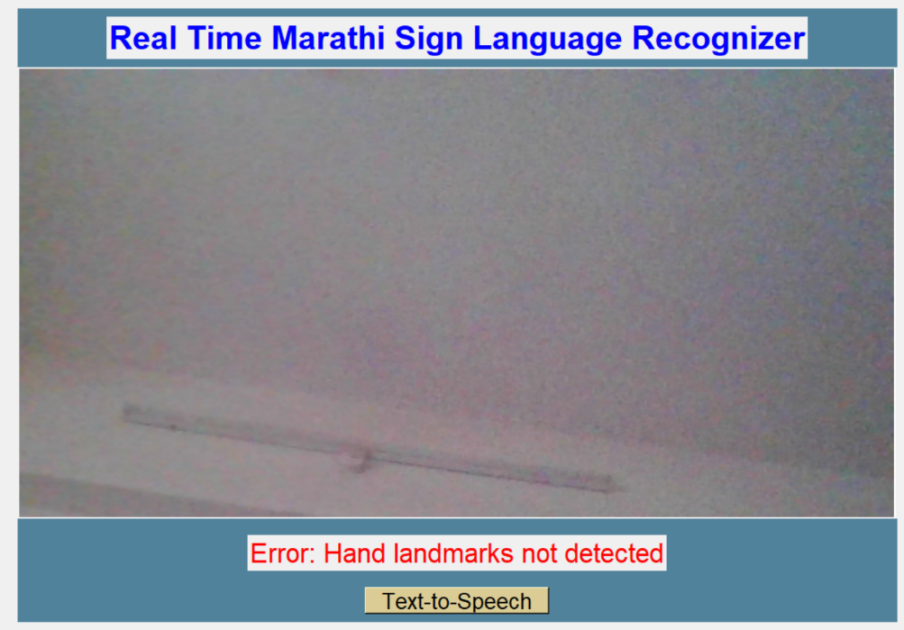
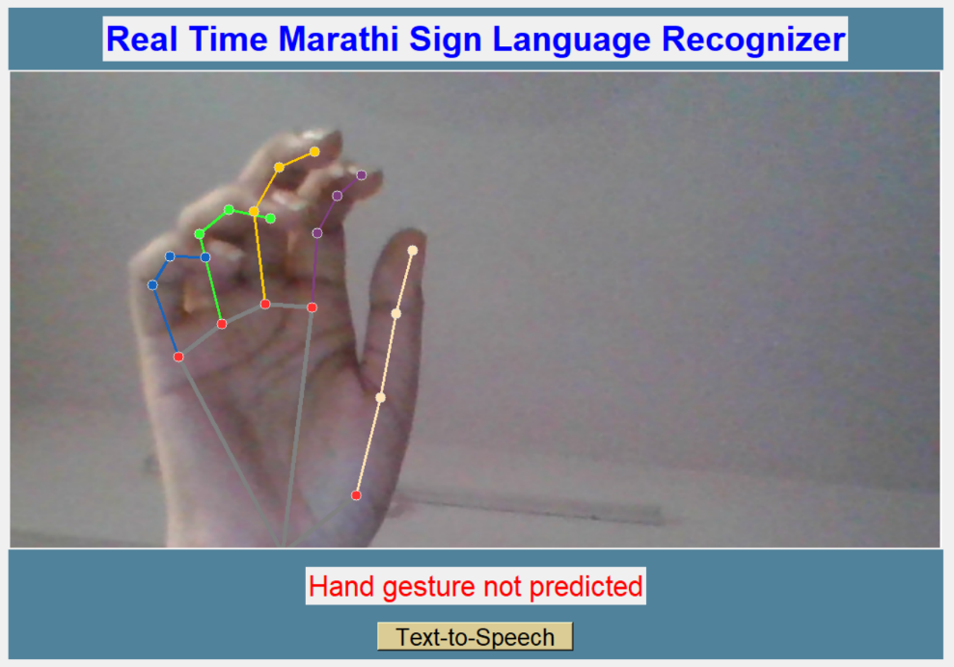
Implementation
The User Interface that pops up after running the application
If any gesture does not exists in the dataset then it will give a message saying “Hand gesture not predicted”.

Slide 30
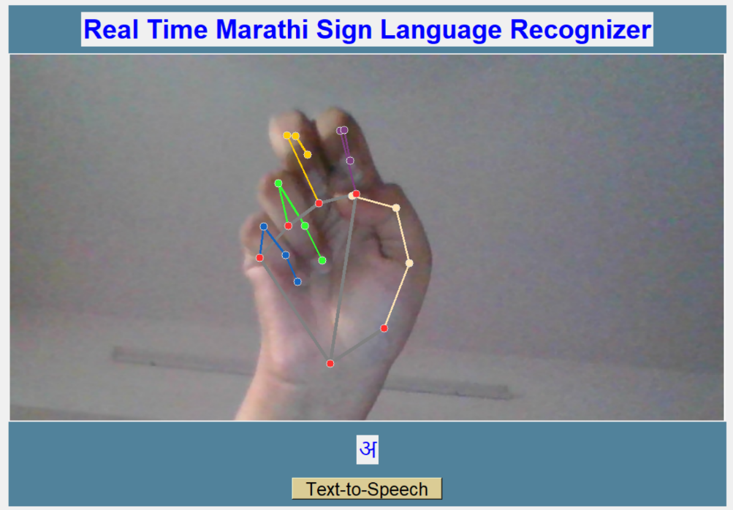
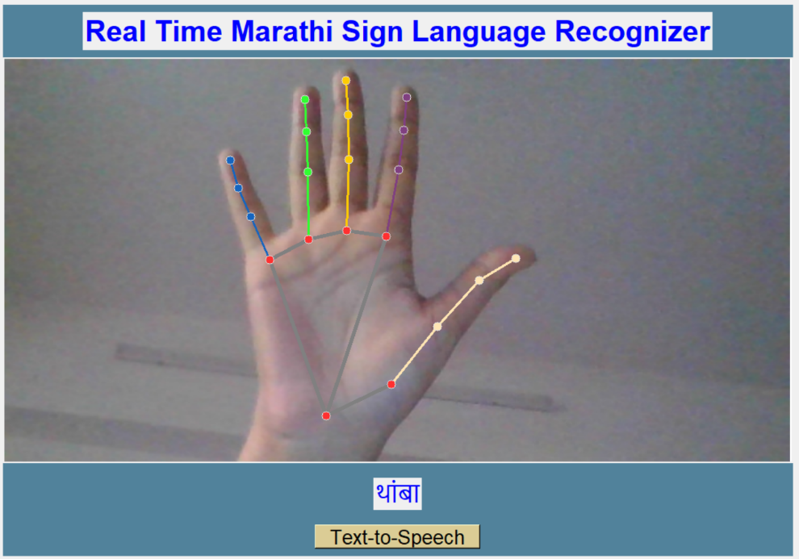
Implementation
The system can predict Marathi alphabets – ‘Swar’ & ‘Vyanjan’ based on whether they exist in its dataset or not.
Similarly, it can also predict the words or phrases which are available in the dataset.

Slide 31
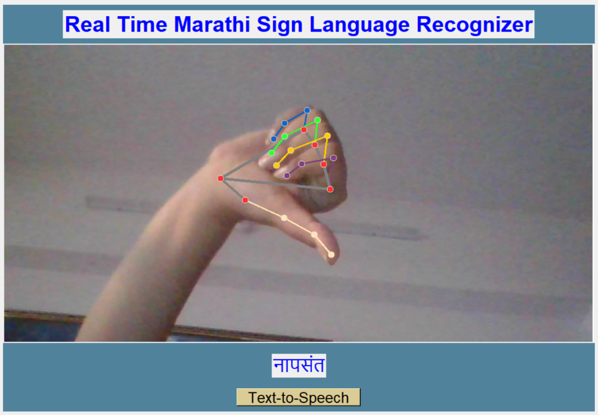
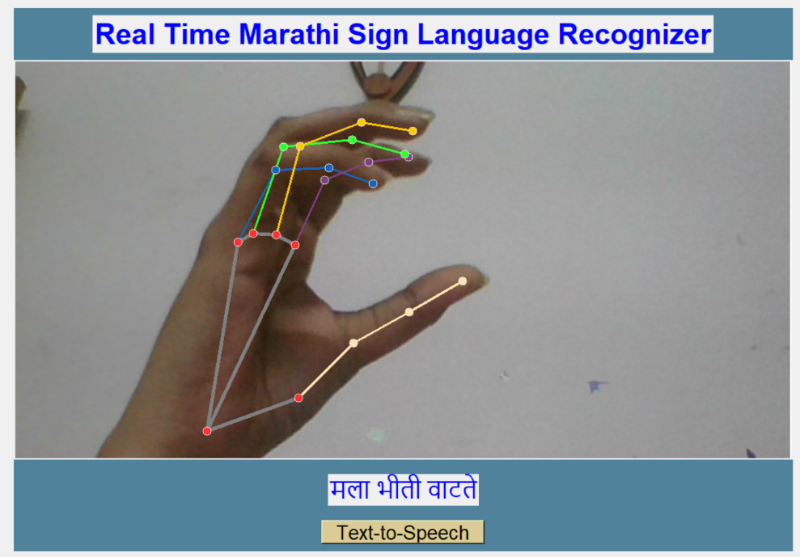
Implementation
Once the gesture is recognized, its meaning is displayed in the form of text below (as shown).
The user also has the choice to convert the displayed text into speech format.

Slide 32
Conclusion
The Marathi Sign Language Recognizer is like a smart tool that helps deaf people who use Marathi Sign Language communicate better. It can turn their signs into spoken words, making it easier for them to talk to people who don't understand sign language. It's like a bridge between two different ways of communicating.
Additionally, it can also read written Marathi text out loud, which can be helpful for people who have trouble reading or seeing. So, it's not only for the deaf but also for others who may need assistance with reading.
This technology is a big step towards making communication easier and more inclusive for everyone.

Slide 33
Reference
[1] Amrutha K, Prabhu P. Features extraction using different algorithms like Decision Tree, Naïve Bayes, ANN algorithms ,etc. May 2021.
[2] Swaraj Dahibavkar, Jayesh Dhopte, Mahesh Patole, Sulochana Madachane. Handling left and right hand gestures simultaneously. May 2020.
[3] Anup Kumar, Karun Thankachan, Mevin M. Dominic. To get maximum accuracy while operating in different backgrounds, use of sphinx module for speech recognition.
[4] Kartik Shenoy, Tejas Dastane, Varun Rao, Devendra Vyavaharkar. Grid based feature extraction technique. July 2018
[5] Amitkumar Shinde & Ramesh Kagalkar. Sign language recognition even in offline mode with 90% accuracy. May 2015
[6] Razieh Rastgoo, Kourosh Kiani, Sergio Escalera. Including other bodily gestures like face, hands,etc. July 2018

Slide 34
Reference
[7] Random forest algorithm working https://www.ibm.com/topics/random-forest accessed on 31 August 2023
[8] CNN https://www.javatpoint.com/k-nearest-neighbor-algorithm-for-machine-learning accessed on 31 August 2023
[9] Comparison of Random Forest and k-Nearest Neighbor https://www.ncbi.nlm.nih.gov/pmc/articles/PMC5796274/ accessed on 8 September 2023

Slide 35
Thank you !!!

